Slide 1

Machine Learning Project - Churn Modelling
Capstone project group-3
Team member:-Aneesh sharma

Slide 2
contents :-
BUSINESS OBJECTIVE
PROBLEM STATEMENT
FEATURE TRANSFORMATION
HEAT MAP FOR TUNNED TRANSFORMED VARIABLES
LABEL ENCODING & SMOTE
BUILD AND EVALUATE MODELS
HYPER PARAMETER TUNING USING GRID SEARCH
SHAP(SHAPELY ADDITIVE EXPLANATIONS)

Slide 3

Business Objective :-
Customer churn is a concerning problem for large companies (especially in the Telecom field) due to its direct effect on revenues. Companies often seek to know which customers are likely to churn in the recent future so that timely action can be taken to prevent it.

Slide 4
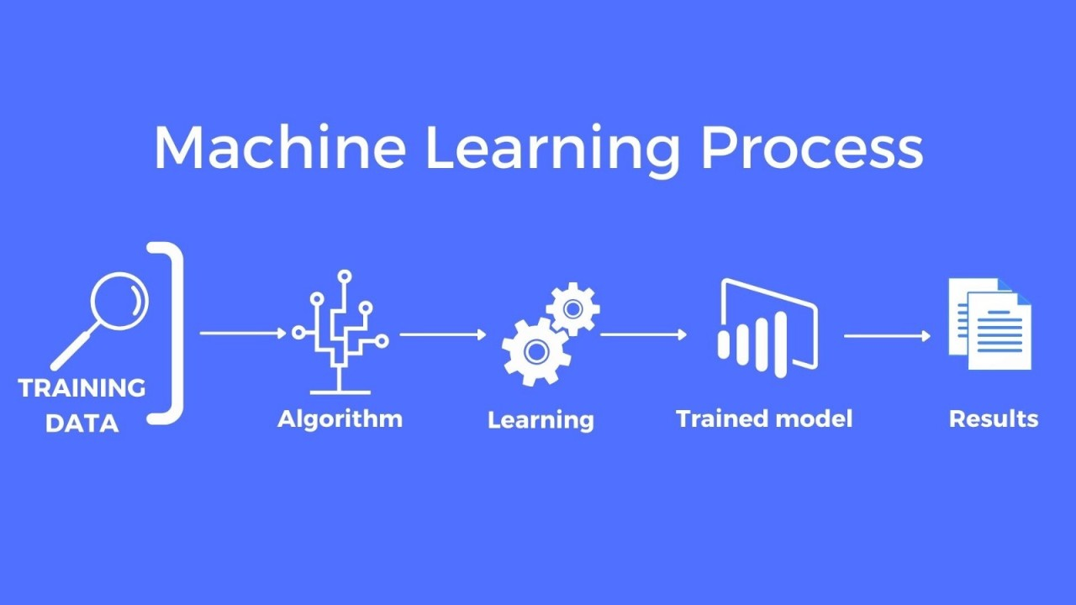
Problem statement:-
Build Machine Learning models that predict which customers are likely to churn.

Slide 5
FEATURE TRANSFORMATION:-
The distribution plots for all the variables in the dataset show varying degrees of skewness and kurtosis. Next, we'll perform feature transformations (square, square root, exponential, and log) to achieve a more symmetrical distribution for each variable and then plot the transformed variables.
Feature transformation involves converting or modifying features in a dataset to improve the performance of a machine learning model. The goal is to enhance the model's ability to learn patterns from the data.

Slide 6
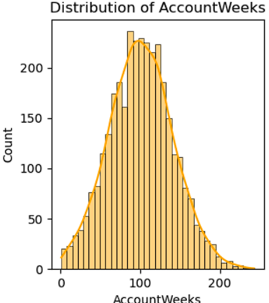
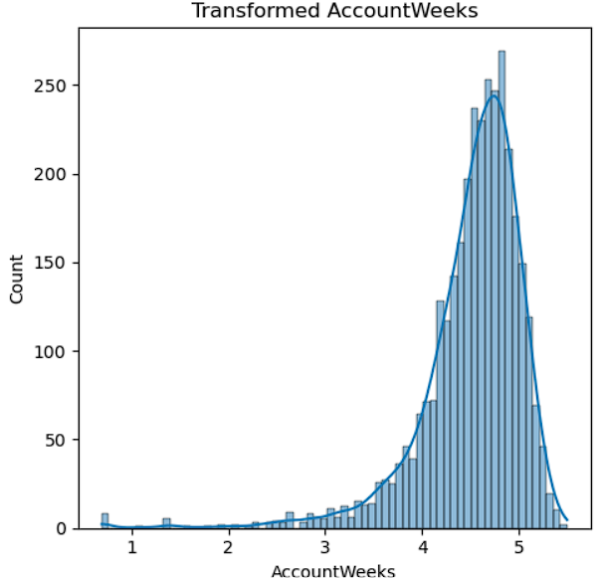
FEATURE TRANSFORMATION:-

Slide 7
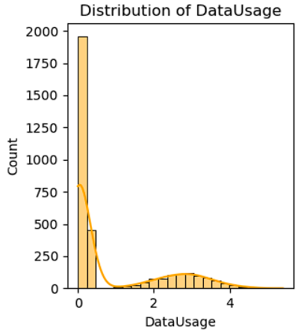
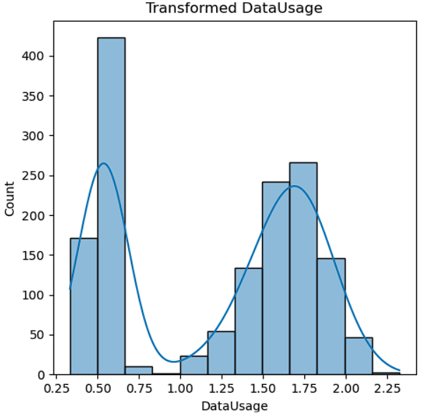
FEATURE TRANSFORMATION:-

Slide 8
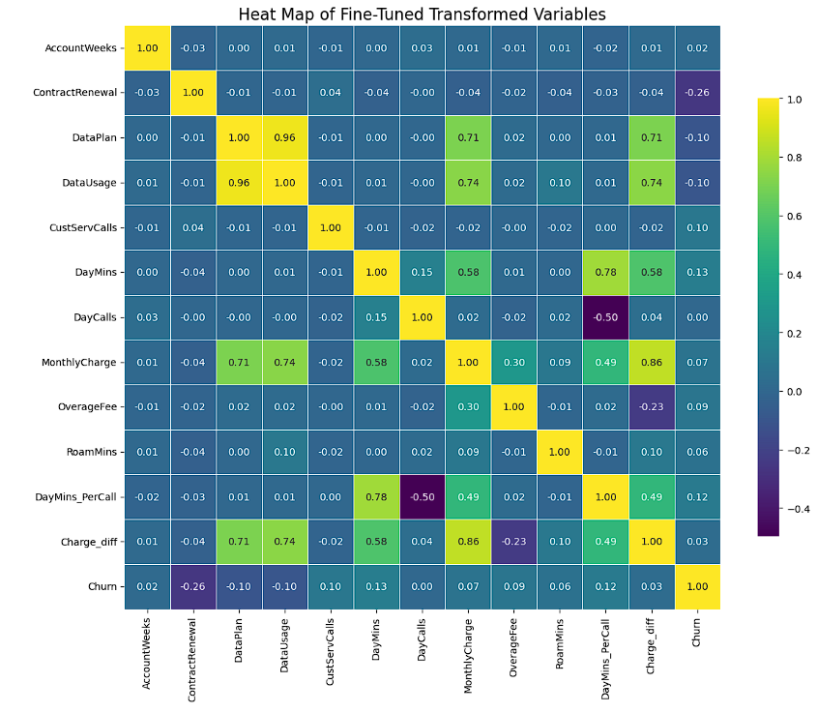
Heat map for tunned transformed variables:-
Churn is directionally proportional to charge diff & Day mins.
Charge diff is directly proportional to Day mins per call, Data usage, Data plan & Monthly charge.
DayMins per call is directly proportional to charge diff,Day mins per call.

Slide 9
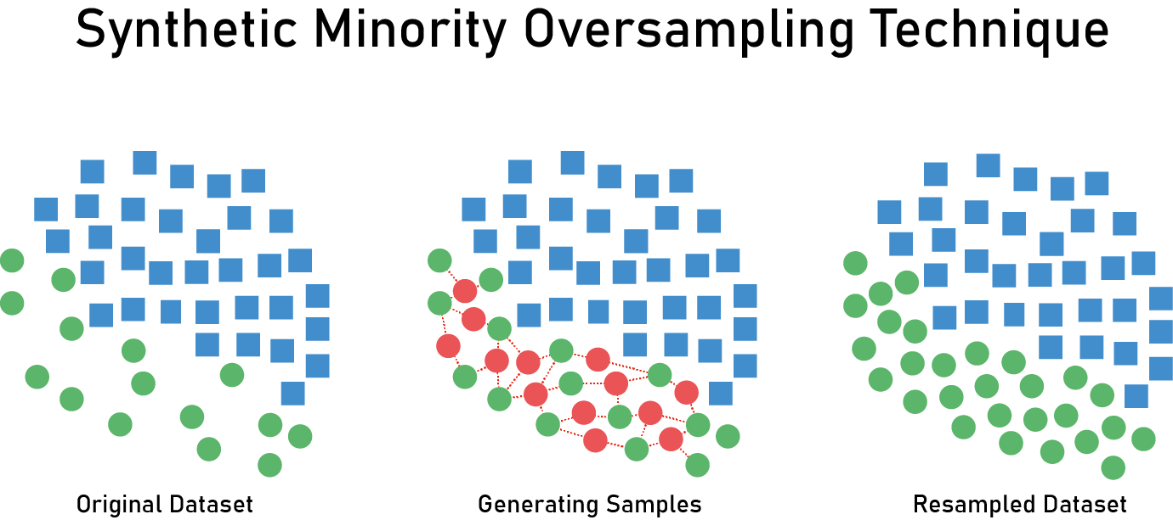
LABEL ENCODING & SMOTE :-
We will convert the categorical variable "MonthlyUsageCategory" to numerical before applying SMOTE.
Label Encoding is a technique used to convert categorical data into numerical format, which can be used by machine learning algorithms. In label encoding, each unique category value is assigned a numeric label.
SMOTE (Synthetic Minority Over-sampling Technique) is a popular method used to address the issue of imbalanced datasets in machine learning. It works by generating synthetic samples for the minority class to balance the dataset.

Slide 10
BUILD AND EVALUATE MODELS:-
LOGISTIC
DECISION TREE
RANDOM FOREST
GRADIENT BOOSTING
KNN
ADA BOOST
XGBOOST
LIGHTGBM
CATBOOST
LGBM

Slide 11
BUILD AND EVALUATE MODELS:-
LOGISTIC REGRESSION:-Logistic Regression is a linear model used for binary classification tasks. It estimates the probability that a given input belongs to a certain class using a logistic function.
DECISION TREE:-A Decision Tree is a non-linear model that splits the data into subsets based on feature values, creating a tree-like structure of decisions.
RANDOM FOREST:-Random Forest is an ensemble model that uses multiple decision trees to improve prediction accuracy and control over-fitting.
GRADIENT BOOSTING:-Gradient Boosting builds an ensemble of trees sequentially, where each tree corrects errors from the previous ones.
K-Nearest Neighbours (KNN):-KNN is a non-parametric algorithm that classifies instances based on the majority class among the nearest neighbors.
AdaBoost:-AdaBoost is an ensemble method that adjusts the weights of incorrectly classified instances, boosting the performance of weak classifiers.
XGBoost:-XGBoost is an efficient and scalable implementation of gradient boosting, often achieving high performance with its regularization techniques.
LightGBM:-LightGBM is a gradient boosting framework that uses tree-based learning algorithms, optimized for speed and efficiency.

Slide 12
Importance of every model:-
DECISION TREE:-A Decision Tree is a non-linear model that splits the data into subsets based on feature values, creating a tree-like structure of decisions
Identifies critical decision points influencing churn.
Visualizes the decision-making process, making it easy to interpret.
Handles both numerical and categorical features effectively.

Slide 13
Importance of every model:-
RANDOM FOREST:-Random Forest is an ensemble model that uses multiple decision trees to improve prediction accuracy and control over-fitting
Aggregates multiple decision trees to improve prediction accuracy.
Reduces overfitting by averaging out biases from individual trees.
Provides feature importance insights for understanding churn drivers.

Slide 14
Importance of every model:-
Xg Boost:- XGBoost is an efficient and scalable implementation of gradient boosting, often achieving high performance with its regularization techniques
Efficiently handles large datasets and sparse features.
Regularizes to prevent overfitting while boosting performance.
Provides high accuracy and speed in churn prediction tasks.

Slide 15
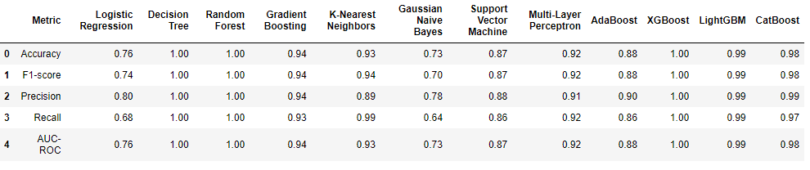
BUILD AND EVALUATE MODELS:-
Accuracy score for Decision Tree ,Random Forest & XG boost is one.
F1-score for Decision Tree,Random Forest & XG boost is one.
Precision score for Decision Tree,Random Forest & XG boost is one.

Slide 16
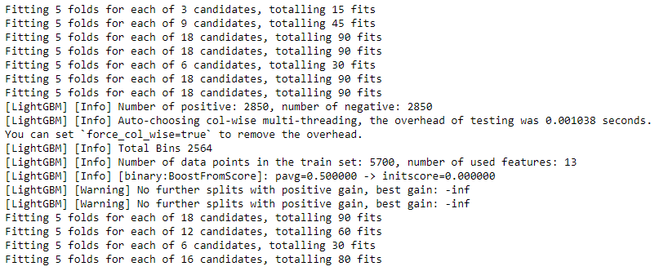
Hyper Parameter Tuning using Grid Search:-
Hyperparameter tuning optimizes the performance of each model by searching for the best combination of parameters using GridSearchCV. This process ensures each model (e.g., Logistic Regression, Decision Tree, Random Forest, etc.) is configured with the most effective parameters to maximize accuracy.

Slide 17
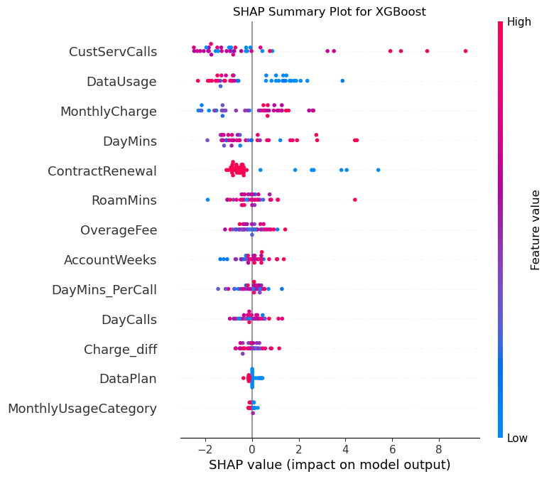
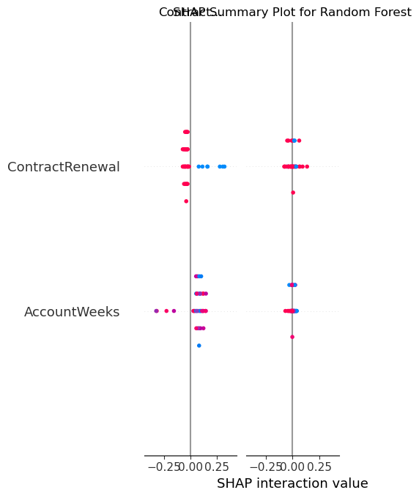
SHAP(SHAPELY ADDITIVE EXPLANATIONS):-
SHAP explains the output of machine learning models by computing the contribution of each feature to the predictions. Using Tree Explainer and Kernel Explainer, SHAP values are computed to understand feature importance and visualize how different features impact model predictions

Slide 18
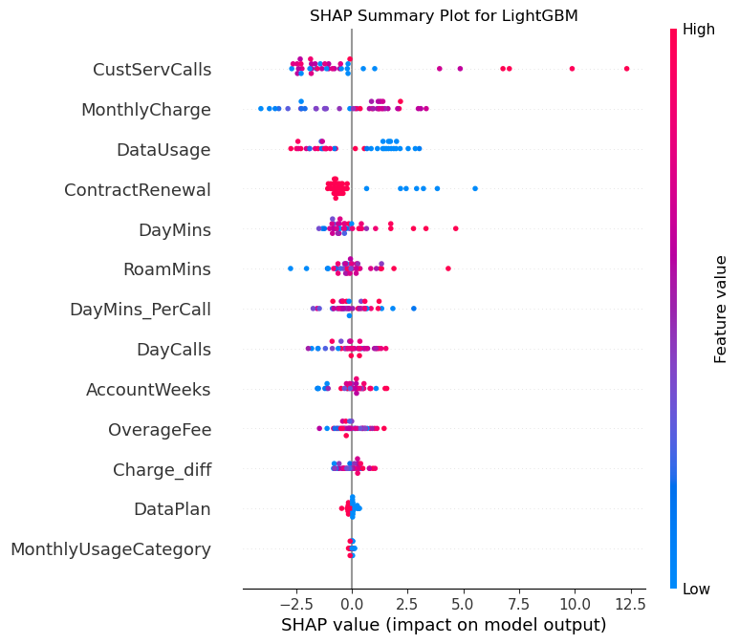
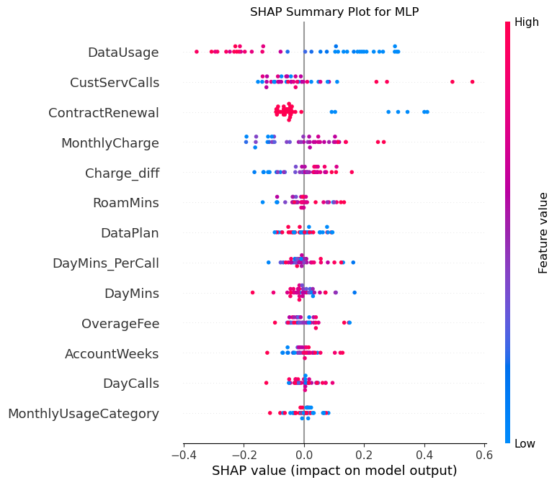
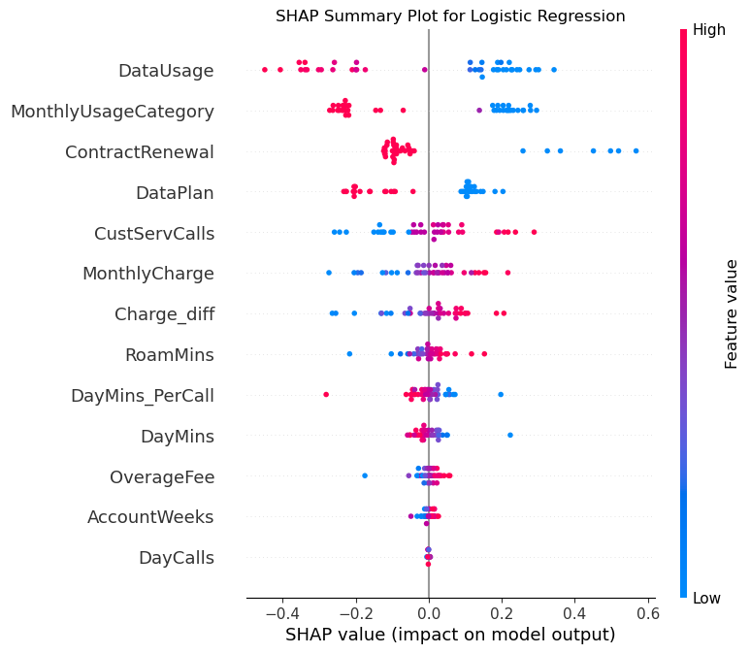
SHAP(SHAPELY ADDITIVE EXPLANATIONS):-

Slide 19
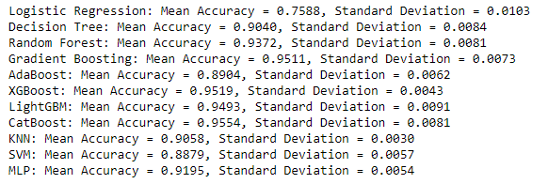
Cross-Validation:-
Cross-validation evaluates the generalizability of the hyperparameter-tuned models. Using Stratified Fold, the dataset is split into multiple folds, and each model is trained and tested on these folds to compute the mean accuracy and standard deviation. This process ensures the models perform consistently and reliably across different subsets of the data.

Slide 20
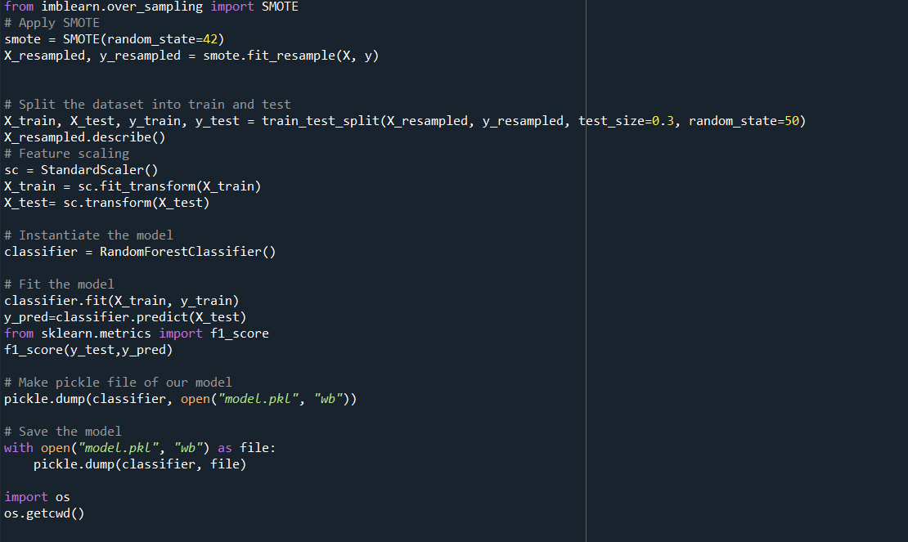
DEPLOYEMENT OF MODEL :-
Deploying a machine learning model involves several steps, from developing the model to deploying it so it can be used in production. While Spyder is an IDE primarily for development and analysis, you can still prepare your model in Spyder before deploying it. Here’s a general workflow for deploying a machine learning model, using Spyder for development.
Step 1: Model Development in Spyder
Data Preparation
Model Training
Model Evaluation
Model Serialization

Slide 21
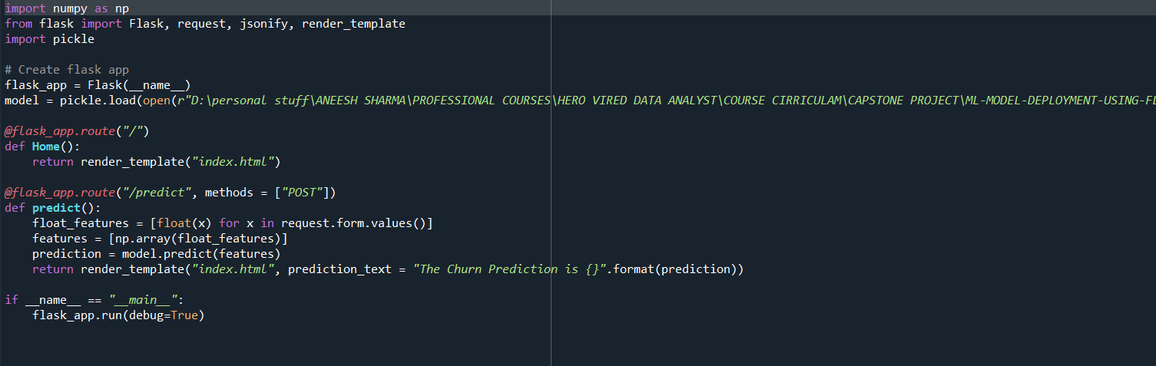
DEPLOYEMENT OF MODEL :-
Step 2: Prepare for Deployment
Choose Deployment Method
Create a Deployment Script
Testing the API:
Deploy to a Server

Slide 22
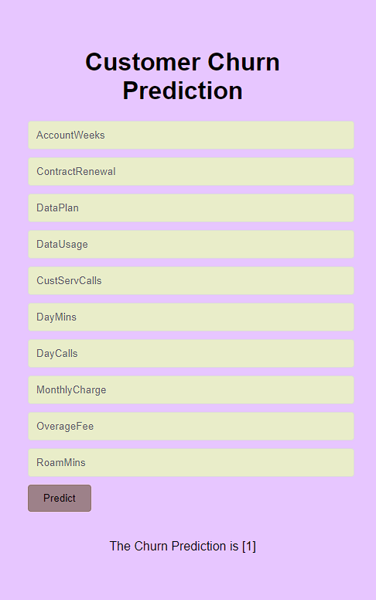
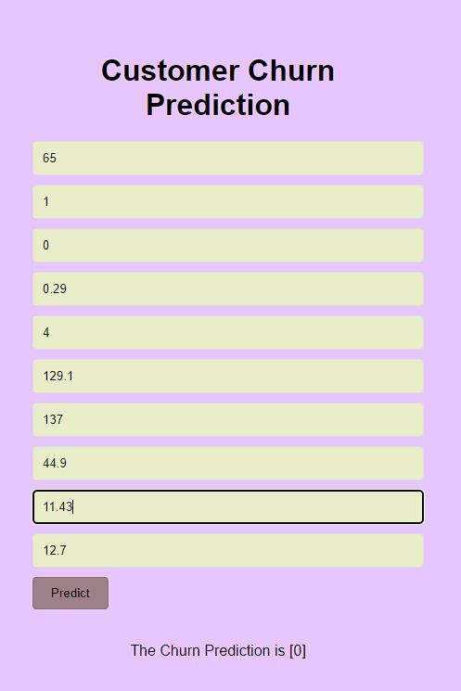
DEPLOYEMENT OF MODEL :-
Step 3: Monitor and Maintain
Logging and Monitoring:
Regular Updates:
Scaling

Slide 23

Thank You

